Slide 1
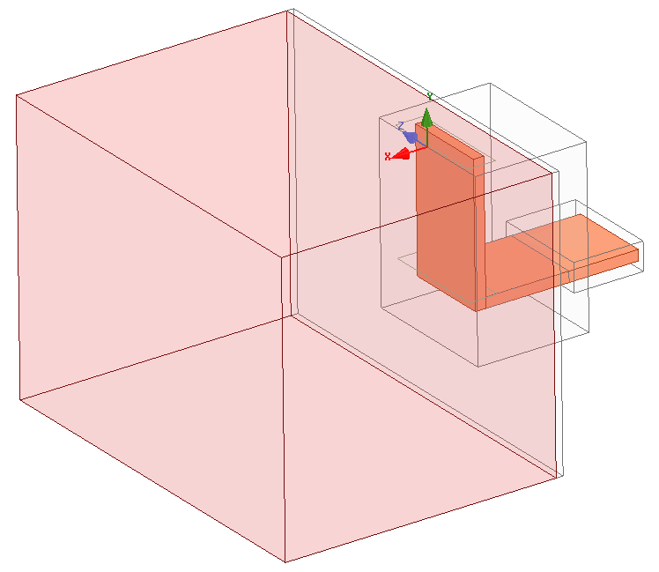
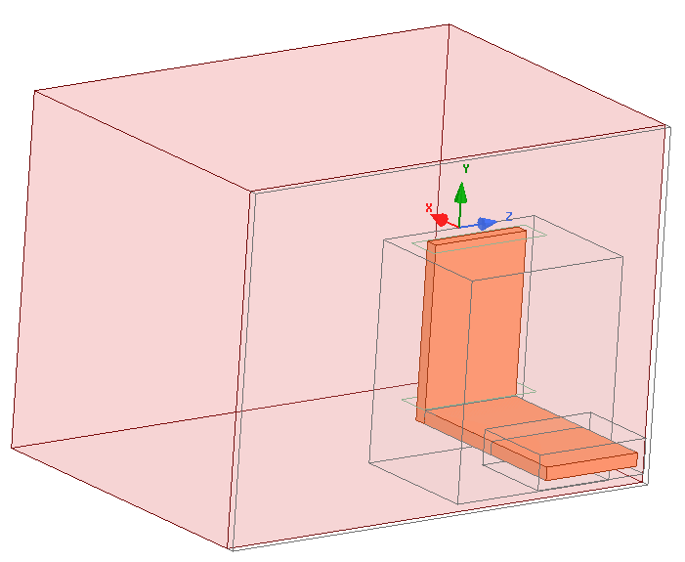
1 strap – lossy water eps_{r}=(81-1j*$losses)
Radiation BCs

Slide 2
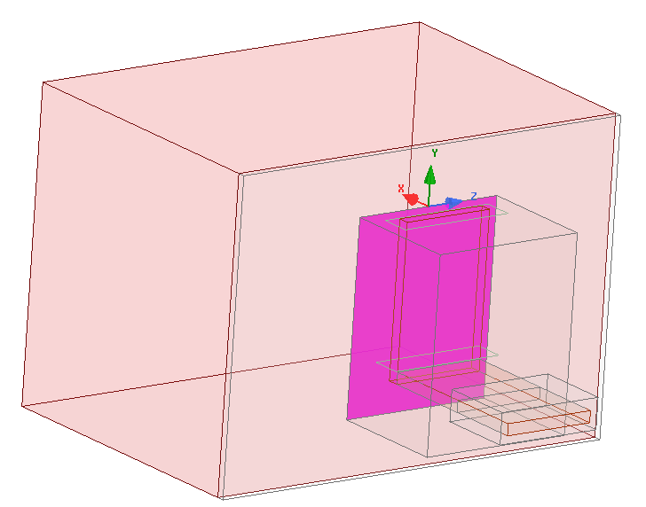
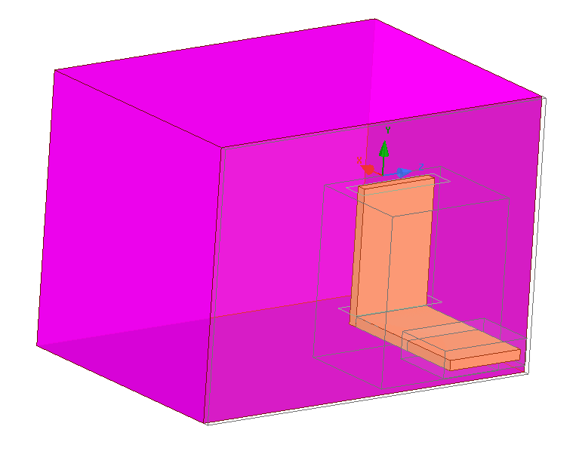
Parameters
P_transferred : int(Re(Poynting))
P_radiated : int(Re(Poynting))
Convergence criterium on Z: 1% real and im parts

Slide 3
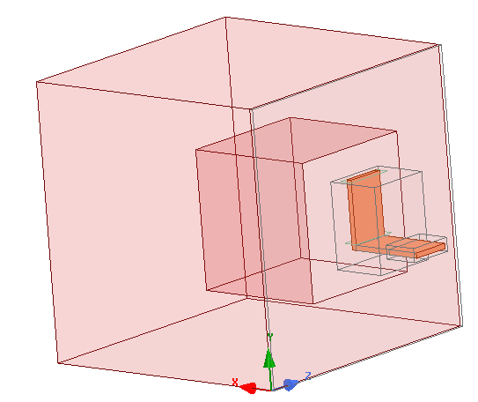
Step 1 : size of the plasma box
Increasing the plasma box size to see the size at which the port impedance converge
losses = 0 → Plasma1=plasma2
Radiation BC
Plasma 2
Plasma 1
d

Slide 4
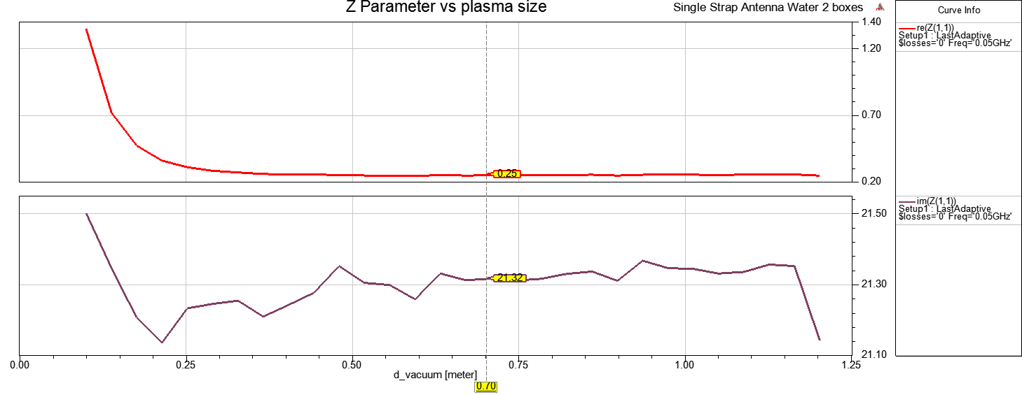
Convergence reached for d_vacuum>0.5m
→ Z=0.25+21.3j

Slide 5
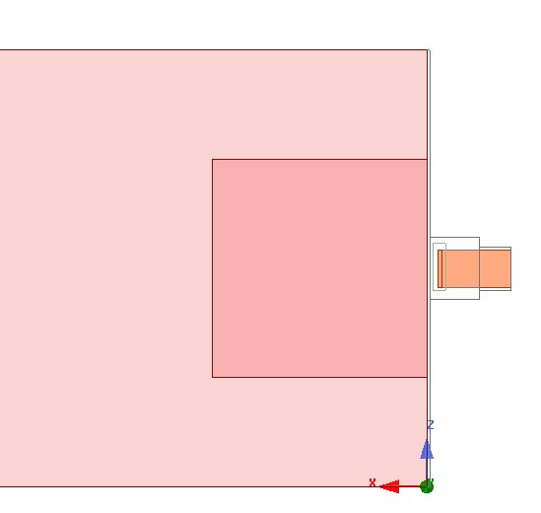
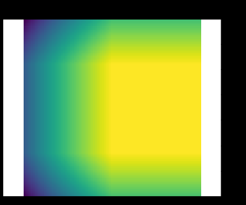
Step2 : creating a lossy plasma surrounding a low lossy plasma
PerfectE BC
d
Plasma1,
Constant losses
ε"(x,z)
ε" = -0.1
Pin
Plasma2,
Increasing losses
Pout

Slide 6

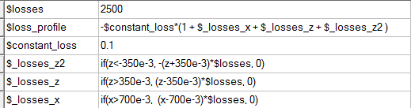
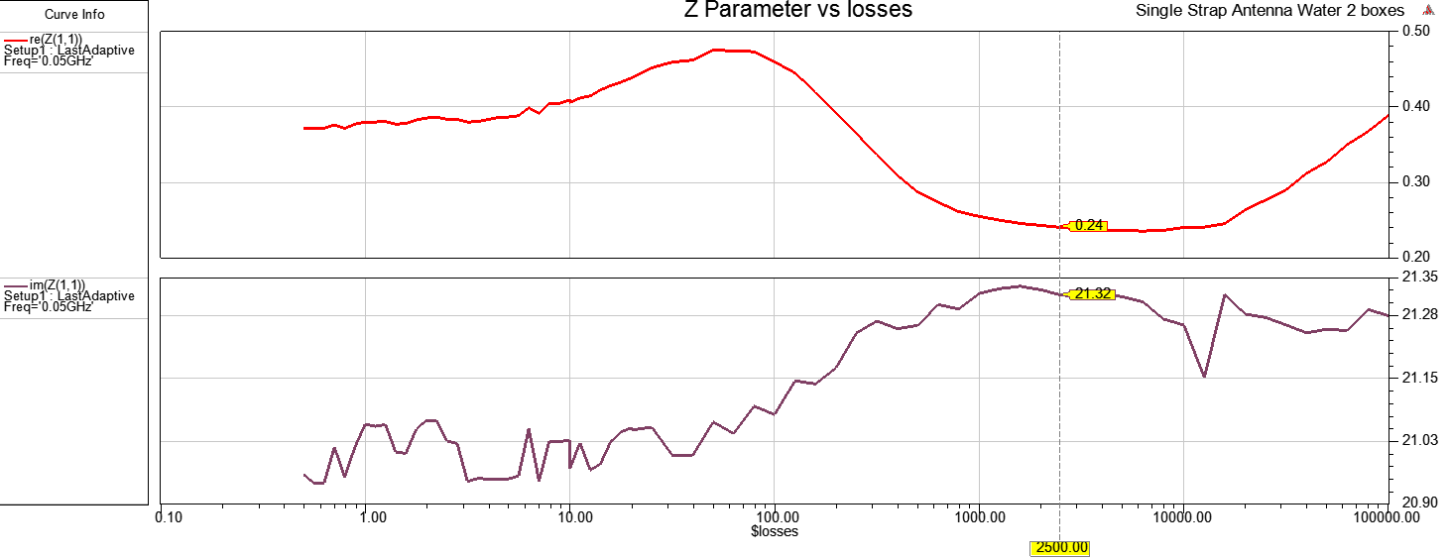
Linear loss evolution
2500

Slide 7
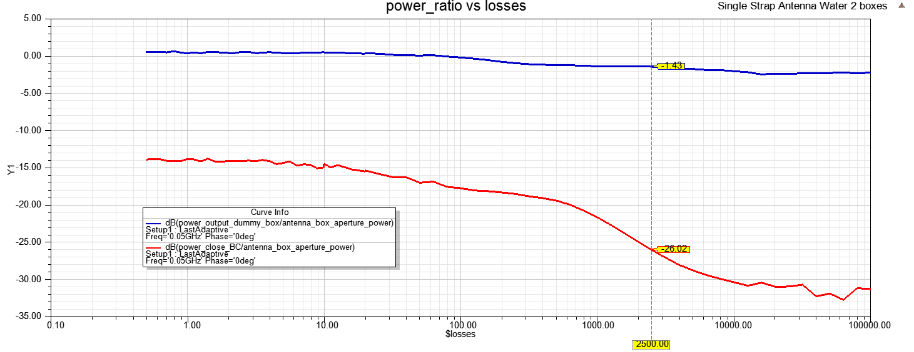

Slide 8
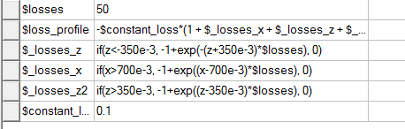
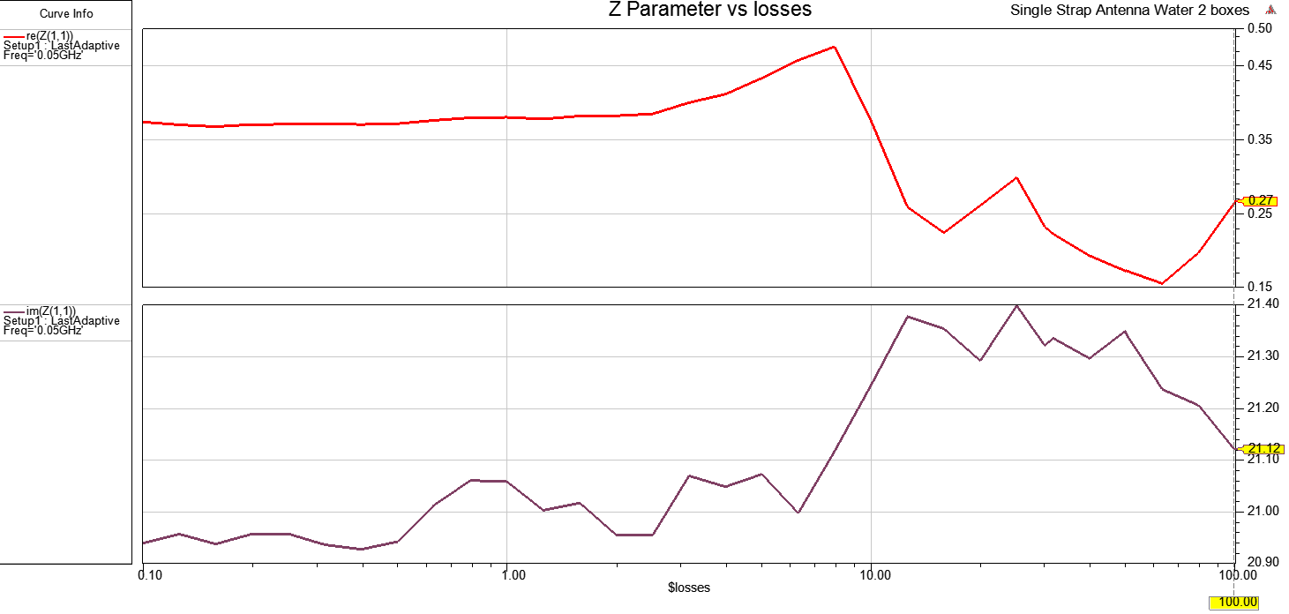
Exponential loss evolution

